Slide 1
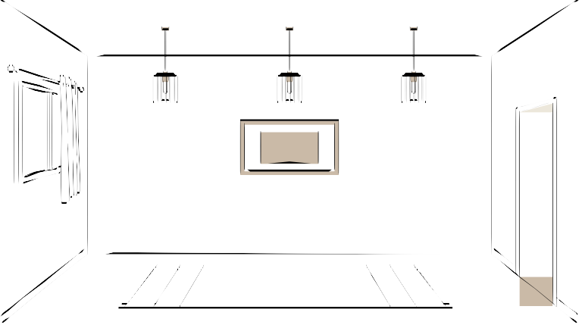




HTML
CSS
JS
Structure/layout
Style
Logic

Slide 2
Level 1

Slide 3
HTML
Hyper Text Markup Language
HTML is the code that is used to structure a web page and its content.
The component used to design the structure of websites are called HTML tags.

Slide 4
First HTML File
index.html
It is the default name for a website's homepage

Slide 5
HTML Tag
A container for some content or other HTML tags
<p> This is a paragraph</p>
Content
Element

Slide 6
Basic HTML Page
<!DOCTYPE html>
<html>
<head>
tells browser you are using HTML5
root of an html document
container for metadata
<title>My First Page</title>
</head>
page title
<body>
<p>hello world</p>
</body>
</html>
contains all data rendered by the browser
paragraph tag

Slide 7

Quick Points
Html tag is parent of head & body tag
Most of html elements have opening & closing tags with content in between
Some tags have no content in between, eg - <br>
We can use inspect element/view page source to edit html

Slide 8
Comments in HTML
This is part of code that should not be parsed.
<!-- This is an HTML Comment -->

Slide 9
HTML is NOT case sensitive
<html> = <HTML>
<p> = <P>
<head> = <HEAD>
<body> = <BODY>

Slide 10
Level 2

Slide 11
Basic HTML Tags
HTML Attributes
Attributes are used to add more information to the tag
<html lang="en">

Slide 12
Heading Tag
Used to display headings in HTML
h1
h2
h3 h4 h5
h6
(most important)
(least important)

Slide 13
Paragraph Tag
Used to add paragraphs in HTML
<p> This is a sample paragraph </p>

Slide 14
Anchor Tag
Used to add links to your page
<a href="https://google.com"> Google </a>

Slide 15
Image Tag
Used to add images to your page
<img src="/image.png" alt="Random Image">
relative url

Slide 16
Br Tag
Used to add next line(line breaks) to your page
<br>

Slide 17
Bold, Italic & Underline Tags
Used to highlight text in your page
<b> Bold </b>
<i> Italic </i>
<u> Underline </u>

Slide 18
Big & Small Tags
Used to display big & small text on your page
<big> Big </big>
<small> Small </small>

Slide 19
Hr Tag
Used to display a horizontal ruler, used to separate content
<hr>

Slide 20
Subscript & Superscript Tag
Used to display a horizontal ruler, used to separate content
<sub> subscript </sub>
H O
2
<sup> superscript </sup>
n
A + B

Slide 21
Pre Tag
Used to display text as it is (without ignoring spaces & next line)
<pre> This
is a sample text.
</pre>

Slide 22
Level 3

Slide 23
Page Layout Techniques
using Semantic tags for layout
using the Right Tags
<header>
<main>
<footer>

Slide 24
Inside Main Tag
Section Tag For a section on your page
<section>
Article Tag For an article on your page
<article>
Aside Tag
For content aside main content(ads)
<aside>

Slide 25
Revisiting Anchor Tag
<a href="https://google.com" target="_main"> Google </a>
for new tab
<a href="https://google.com"> <img src="link"> </a>
clickable pic

Slide 26
Revisiting Image Tag
<img src="link" height=50px >
set height
<img src="link" width=50px >
set width

Slide 27
Div Tag
Div is a container used for other HTML elements
Block Element (takes full width)

Slide 28
List : Div Tags
<address>
<article>
<aside>
<blockquote>
<canvas>
<dd>
<div>
<dl>
<dt>
<fieldset>
<figcaption>
<figure>
<footer>
<form>
<h1>-<h6>
<header>
<hr>
<li>
<main>
<nav>
<noscript>
<ol>
<p>
<pre>
<section>
<table>
<tfoot>
<ul>
<video>

Slide 29
Span Tag
Span is also a container used for other HTML elements
Inline Element (takes width as per size)

Slide 30
<code>
<output>
<q>
<samp>
<script>
<select>
<small>
<span>
<strong>
<sub>
<sup>
<textarea>
<time>
List : Span Tags
<a>
<abbr>
<acronym>
<b>
<bdo>
<big>
<br>
<button>
<cite>
<dfn>
<em>
<i>
<img>
<input>
<kbd>
<label>
<map>
<object>
<tt>
<var>

Slide 31
Level Pro

Slide 32
List in HTML
Lists are used to represent real life list data.
unordered
ordered
<ul>
<ol>
<li> Apple </li>
<li> Apple </li>
<li> Mango </li>
<li> Mango </li>
</ul>
</ol>

Slide 33
Tables in HTML
Tables are used to represent real life table data.
<tr>
<td>
used to display table row
used to display table data
<th>
used to display table header

Slide 34
Name
Tables in HTML
Roll No
Ayush
1901
<table>
<tr>
<th> Name </th>
<th> Roll No </th>
</tr>
<tr>
<td> Ayush </th>
<th> 1901 </th>
</tr>
</table>

Slide 35
Caption in Tables
<caption> Student Data </caption>
Student Data
Name Roll No
Ayush
1901

Slide 36
thead & tbody in Tables
<thead> to wrap table head
<tbody> to wrap table body

Slide 37
colspan attribute
colspan="n"
used to create cells which spans over multiple columns
Data
Ayush
1901
Abhi
1902

Slide 38
Form in HTML
Forms are used to collect data from the user
Eg- sign up/login/help requests/contact me
<form>
form content
</form>

Slide 39
Action in Form
Action attribute is used to define what action needs to be performed when a form is submitted
<form action="/action.php" >

Slide 40
Form Element : Input
<input type="text" placeholder="Enter Name">

Slide 41
Label
<label for="id1">
<input type="radio" value="class X" name="class" id="id1">
</label>
<label for="id2">
<input type="radio" value="class X" name="class" id="id2">
</label>

Slide 42
Class & Id
<div id="id1" class="group1">
</div>
<div id="id2"> class="group1">
</div>

Slide 43
Checkbox
<label for="id1">
<input type="checkbox" value="class X" name="class" id="id1">
</label>
<label for="id2">
<input type="checkbox" value="class X" name="class" id="id2">
</label>

Slide 44
Textarea
<textarea name="feedback" id="feedback" placeholder="Please add Feedback">
</textarea>

Slide 45
Select
<select name="city" id="city">
<option value="Delhi"> Delhi </option>
<option value="Mumbai"> Delhi </option>
<option value="Banglore"> Delhi </option>
</select>

Slide 46
iframe Tag
website inside website
<iframe src="link"> Link </option>

Slide 47
Video Tag
<video src="myVideo.mp4"> My Video </video>
Attributes
controls
height
width
loop
autoplay

Slide 48
All the very best in your future journey :)
Ayush Agarwal

